Slide 1

Clean-Littered Road Classification
Modelway s.r.l - Tech Skill Test Project presentation
Vincenzo Fraello

Slide 2
Assignment
A company that cleans streets must check whether the cleaning was done correctly. We have a dataset of images containing photos of clean streets (class 0: "clean") and with garbage (class 1: "dirty"). The goal is to develop a machine learning model that can accurately distinguish between clean and dirty streets.
Load and pre-process the dataset images.
Choose the appropriate machine learning model.
Train the model.
Evaluate model performance.

Slide 3
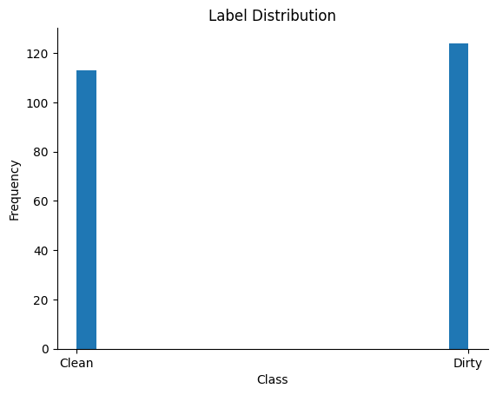
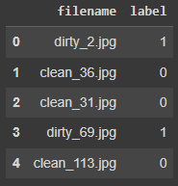
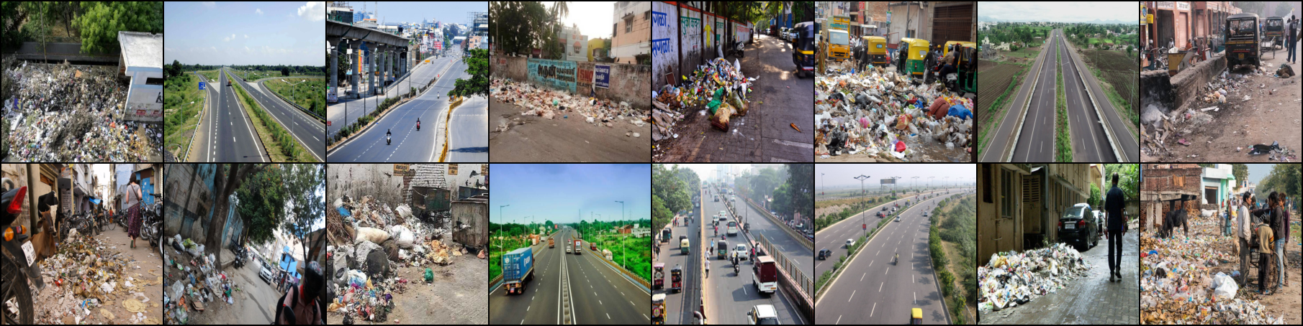
The Dataset
237 unique images.
Balanced dataset.
Images (RGB).
Different resolutions.
Metadata (.csv).

Slide 4
Considerations (1)
Use a pre-trained model due to data scarcity.
Validate with k-fold split cross-validation:
For datasets with 100 to 1,000,000 examples, use k = 5 (20% test set).
Consider hold-out split validation if examples > 10,000.
Reduce overfitting by applying data transformations.

Slide 5
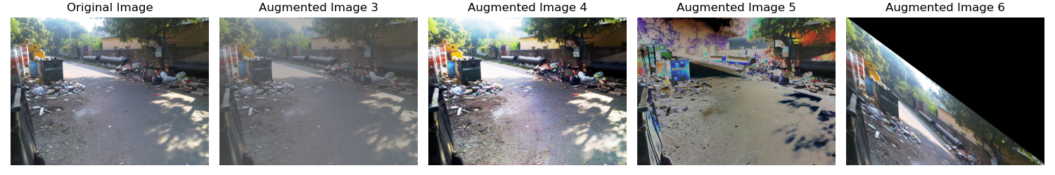
Image Preprocessing (1)
Basic transformations:
Resize: resizes images to 224 × 224 (aligned with the pre-trained model on ImageNet 1K).
Tensor conversion: converts them to tensors (0-1) range.
Augmentations (if enabled): additional advanced data augmentation techniques.

Slide 6
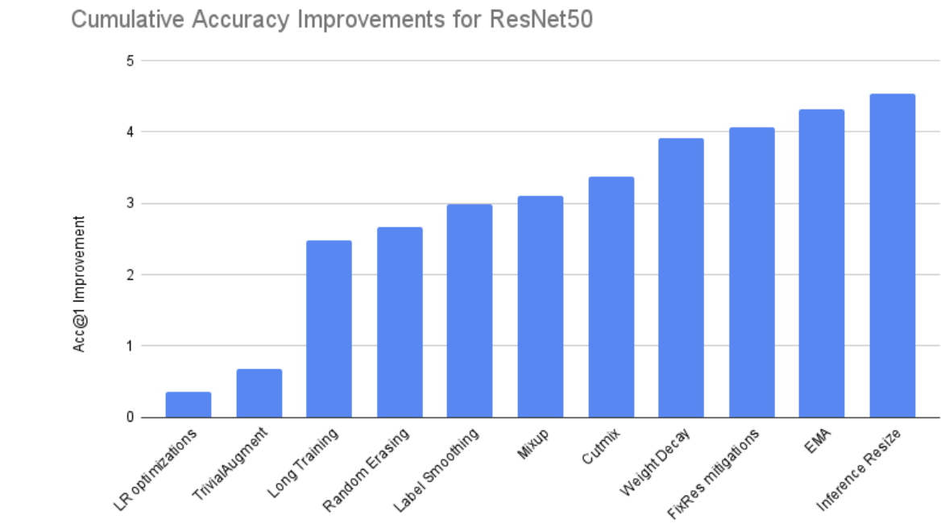
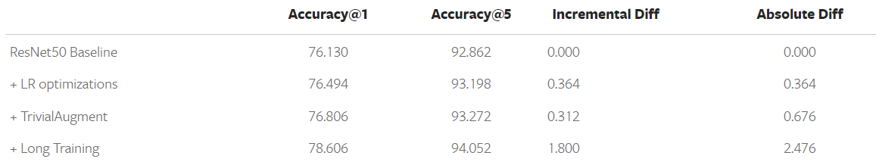
Image Preprocessing (2)
Random-Horizontal-Flip, Random-Vertical-Flip, Random-Rotation, Color-Jitter, Normalize (ImageNet 1K)
Mean = [0.485, 0.456, 0.406]
Std = [0.229, 0.224, 0.225]
TrivialAugmentWide
PyTorch. (2023). torchvision.transforms.TrivialAugmentWide. Retrieved 12-10-23 from https://pytorch.org/vision/main/generated/torchvision.transforms.TrivialAugmentWide.html
Müller, S. G., & Hutter, F. (2021). TrivialAugment: Tuning-free Yet State-of-the-Art Data Augmentation. arXiv preprint arXiv:2103.10158.

Slide 7
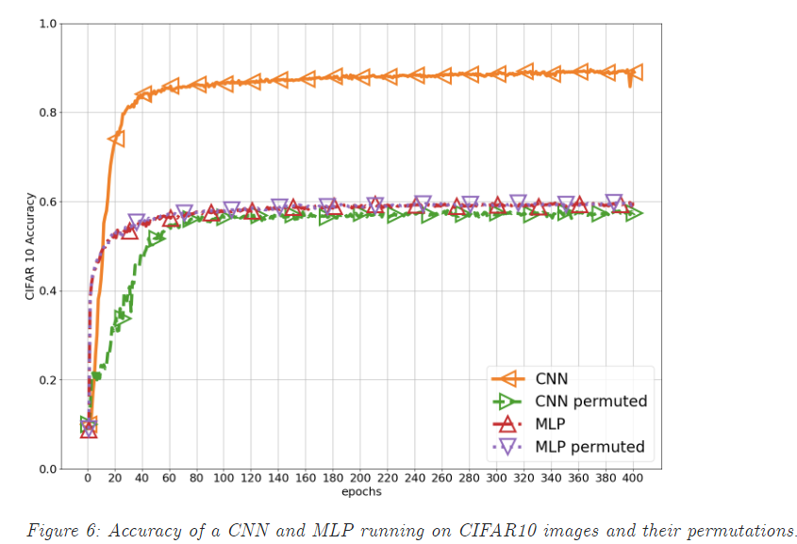
Machine Learning model
The spatial relationships and local patterns within the data play a crucial role in understanding the content
CNN >> MLP:
CNN is mostly used for Image Data, whereas it is better to use ANN on structural data.
CNN has less parameters and tries to reduce the dimensions of image whereas in case of ANN number of parameters depends on the data.
ResNet18, ResNet50, MobileNetV2.
Transfer Learning (data scarcity)
Fixed Feature Extractor (feature learning).
Fine Tuning (train all).
Ivan, C. (2019). Convolutional Neural Networks on Randomized Data. arXiv preprint arXiv:1907.10935.

Slide 8
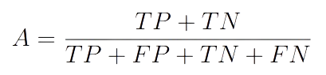
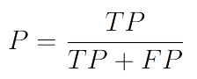
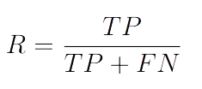
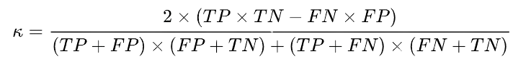
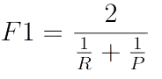
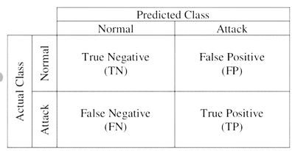
Evaluate model performance
Key metrics commonly used for binary classification problems include:
Accuracy (balanced dataset).
Precision.
Recall.
F1-score.
Confusion Matrix.
ROC Curve.
Precision-Recall Curve.

Slide 9








Languages, Frameworks & Libraries
Python.
PyTorch.
TensorFlow + Keras.
Optuna
Tensorboard.
Matplotlib.
Numpy.
Pandas.

Slide 10
Hyperparameters Selection
External configuration variables to manage the training of machine learning models.
CNN hyperparameters: n. kernels, depth, padding, stride, … (pretrained model).
Learning Rate: optimizers official papers + Optuna.
Optimizer: experience + Optuna.
Batch Size: 16 → good compromise between training time, memory usage, GPU utilization, and performance.

Slide 11
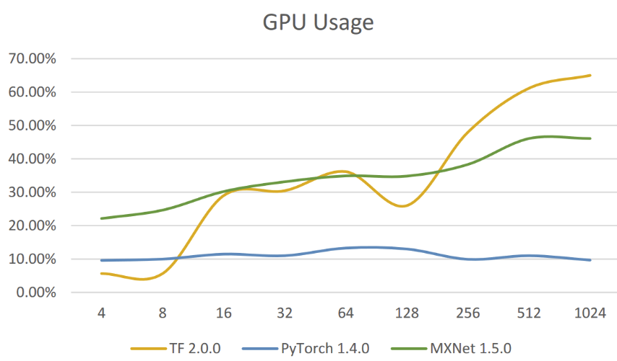

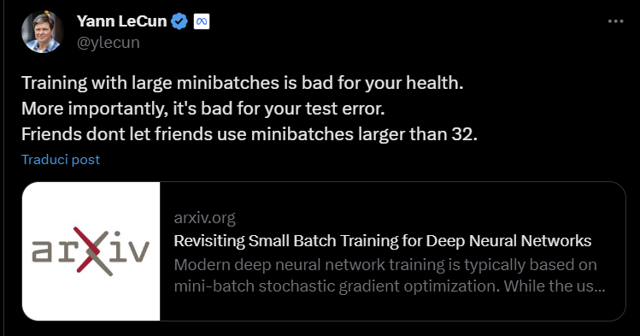
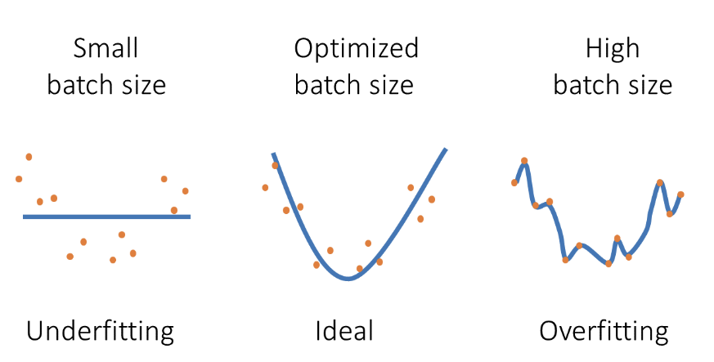
Hyperparameters Selection: Batch Size
https://blog.paperspace.com/how-to-maximize-gpu-utilization-by-finding-the-right-batch-size/

Slide 12
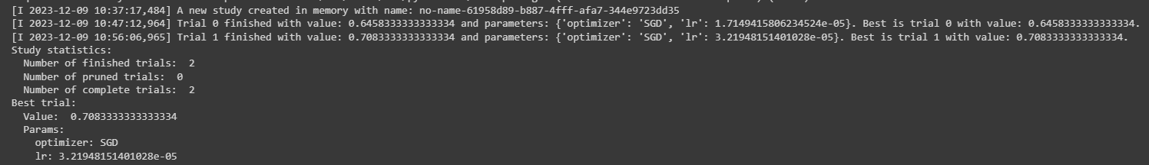
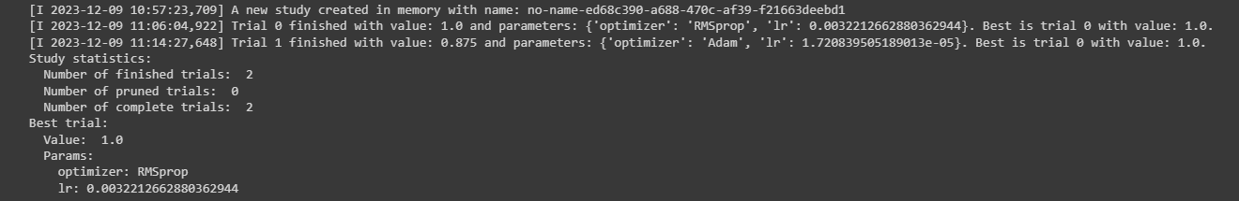
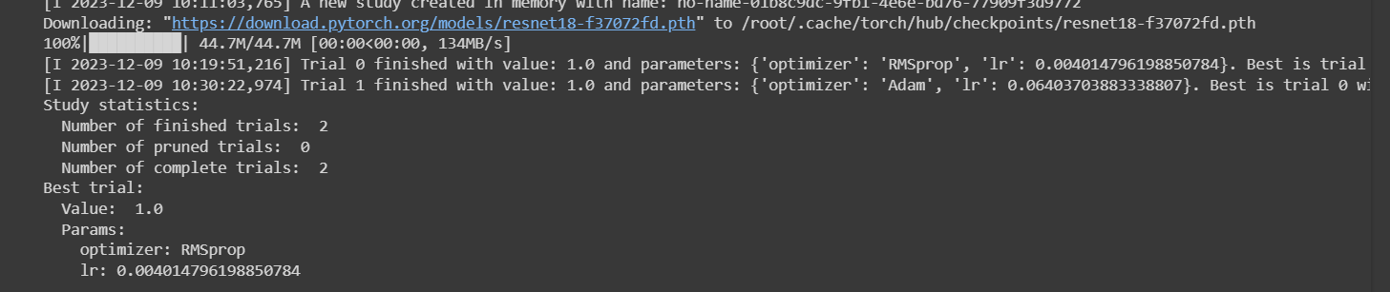
Optuna output
Different executions
Worst case
Optimizer: Adam
Lr: 0.0009.. ≈ 0.001 (official paper)

Slide 13
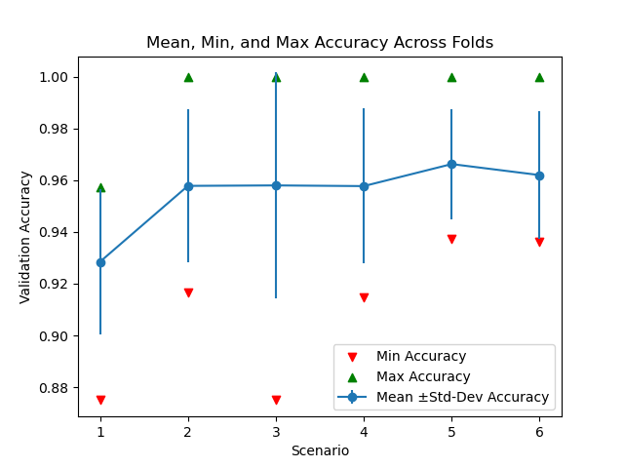
Results: ResNet18
K-Fold split Cross Validation Scenarios:
Test1: RMSprop(lr=0.004) + Custom transforms.
Test2: RMSprop(lr=0.004) + No transforms.
Test3: RMSprop(lr=0.004) + TrivialAugmentWide.
Test4: Adam(lr=0.001) + Custom transforms.
Test5: Adam(lr=0.001) + TrivialAugmentWide.
Test6: Adam(lr=0.001) + No transforms.
Best:
Mean Accuracy = 96.622%.
Standard Deviation = ± 0.0213.

Slide 14
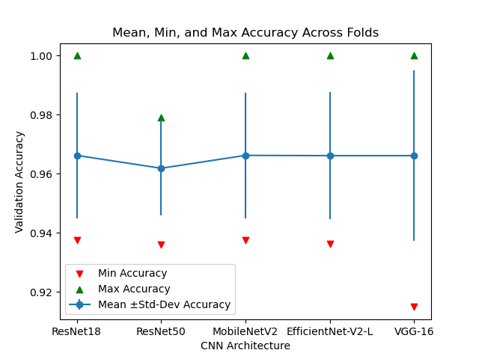
Results: comparison
ResNet18 (Test5): Adam(lr=0.001) + TrivialAugmentWide. (baseline)
Mean Accuracy = 96.622%.
Standard Deviation = ± 0.0213.
#params ≈ 11 million.
ResNet50: Adam(lr=0.001) + TrivialAugmentWide.
Mean accuracy: 96.187%.
Std-Dev: ± 0.0161.
#params: ≈ 23 million.
MobileNetV2: Adam(lr=0.001) + TrivialAugmentWide.
Mean accuracy: 96.622%.
Std-Dev: ± 0.0213.
#params: ≈ 3.4 million.
EfficientNet-V2-L: Adam(lr=0.001) + TrivialAugmentWide.
Mean accuracy: 96.613%.
Std-Dev: ± 0.0216.
#params: ≈ tens of millions.
VGG16: Adam(lr=0.001) + TrivialAugmentWide.
Mean accuracy: 96.613%.
Std-Dev: ± 0.0288.
#params: ≈ 138 million.

Slide 15
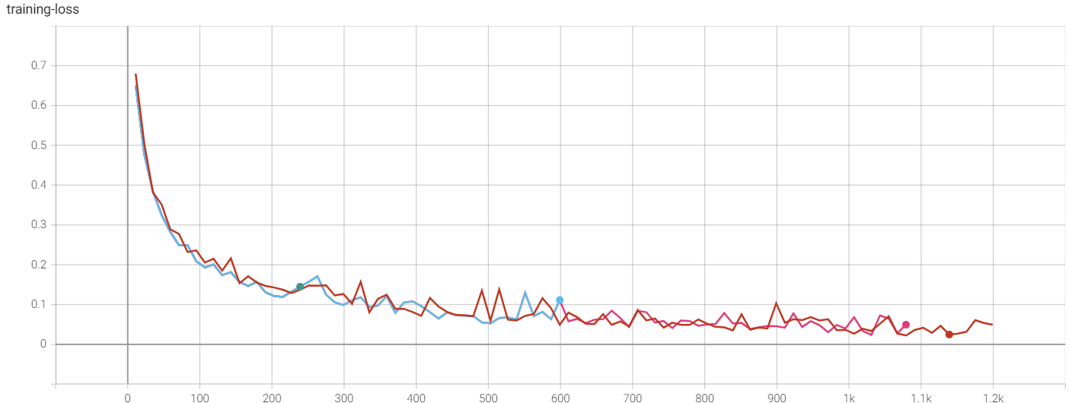
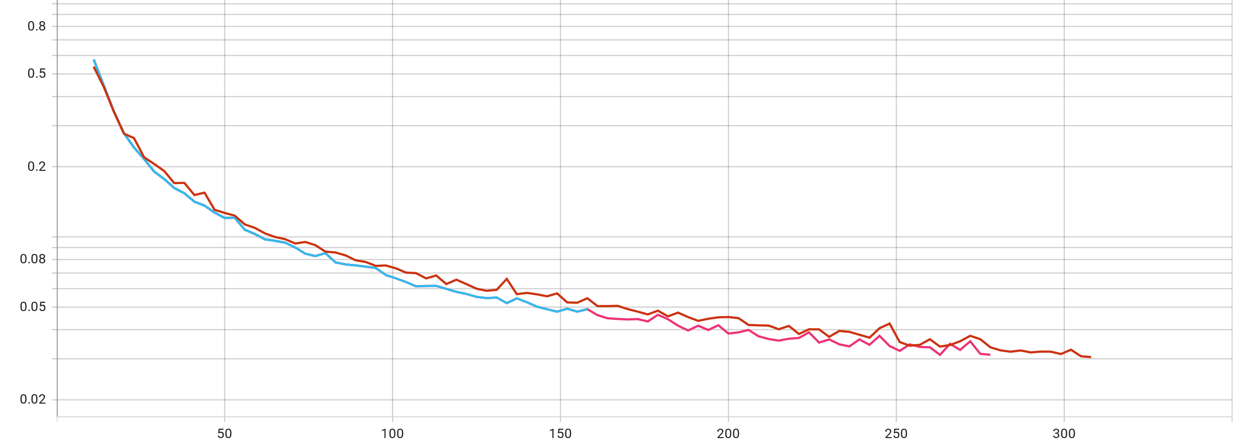
Hold-Out Validation (feature learning): loss
Multiple runs with different seeds

Slide 16
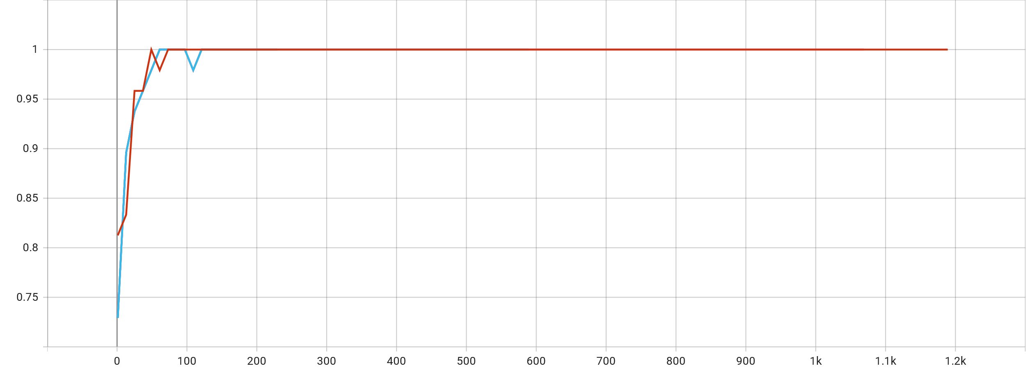
Hold-Out Validation: accuracy
Multiple runs with different seeds

Slide 17
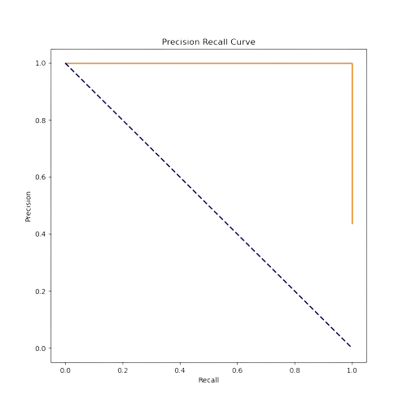
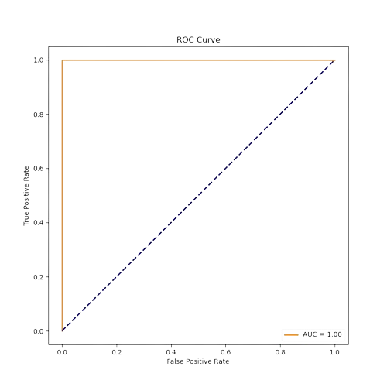
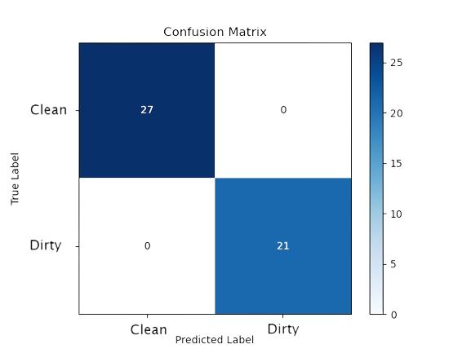
Hold-Out Validation: other metrics
Multiple runs with different seeds
Cl
Di

Slide 18
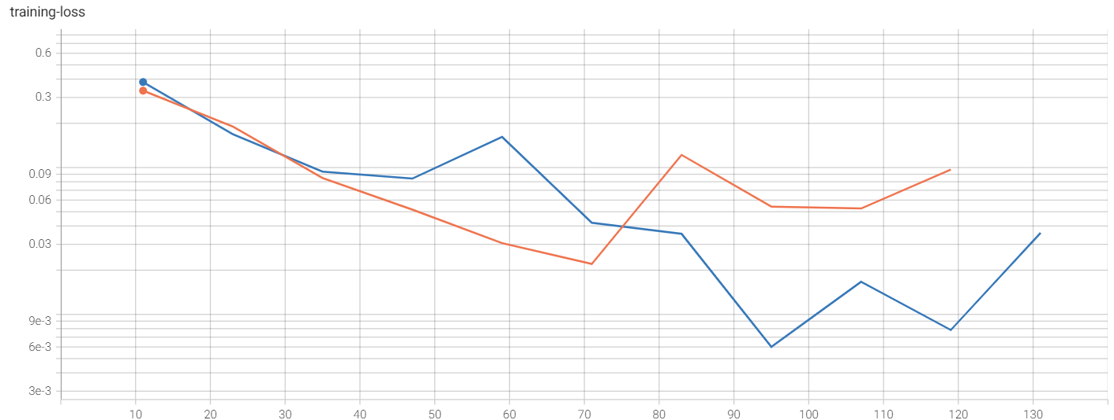
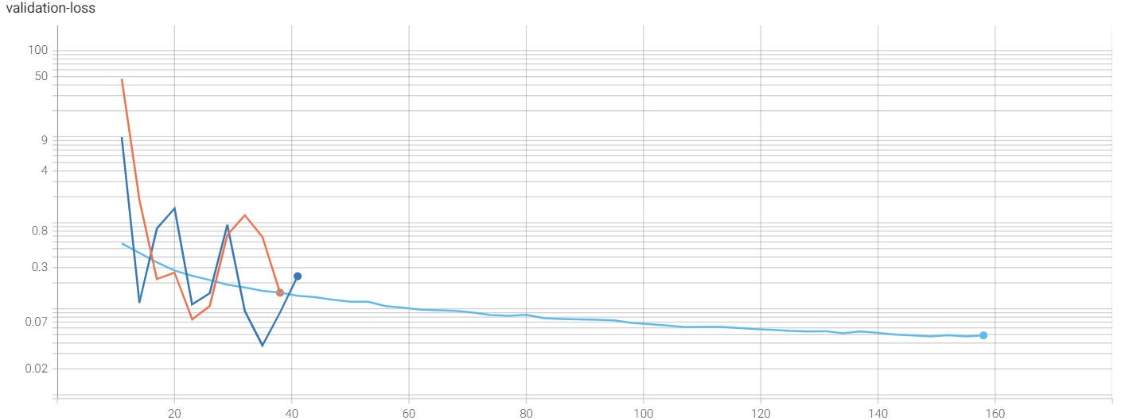
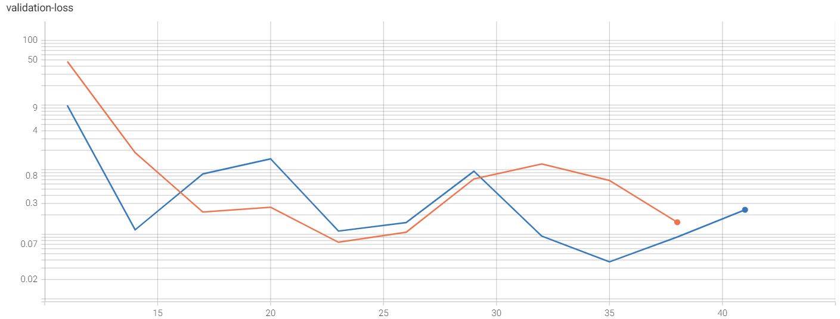
Hold-Out Validation (fine-tuning all): loss
Fine-tuning all vs. Feature Learning

Slide 19
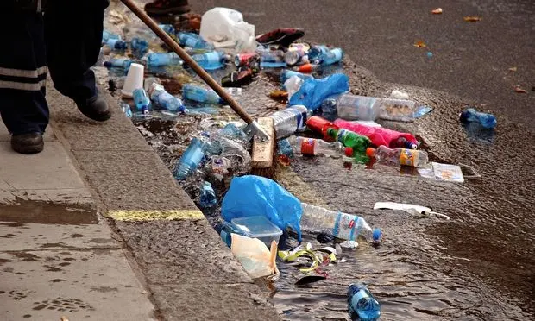
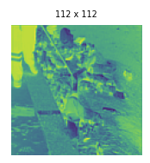
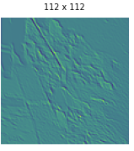
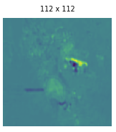
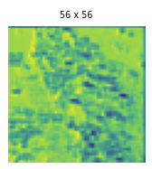
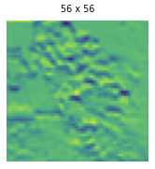
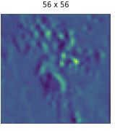
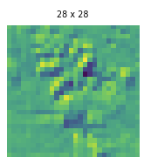
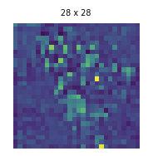
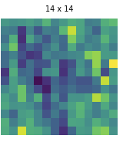
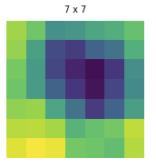
Activations

Slide 20
Analysis of the literature (state-of-the-art)
Papers With Code, arXiv, Google Scholar, …
Ping, Ping & Xu, Guoyan & Kumala, Effendy & Gao, Jerry. (2020). Smart Street Litter Detection and Classification Based on Faster R-CNN and Edge Computing. International Journal of Software Engineering and Knowledge Engineering. 30. 537-553. 10.1142/S0218194020400045.
Majchrowska, S., Mikołajczyk, A., Ferlin, M., Klawikowska, Z., Plantykow, M. A., Kwasigroch, A., & Majek, K. (2022). Deep learning-based waste detection in natural and urban environments. Waste Management, 138, 274-284. https://doi.org/10.1016/j.wasman.2021.12.001
ResNet50, EfficientNet.
Other datasets:
Open Litter (outdoor)
TrashNet (indoor)
Waste (outdoor)
Places (background)
https://github.com/AgaMiko/waste-datasets-review

Slide 21
Thanks for the attention!

